Slide 1



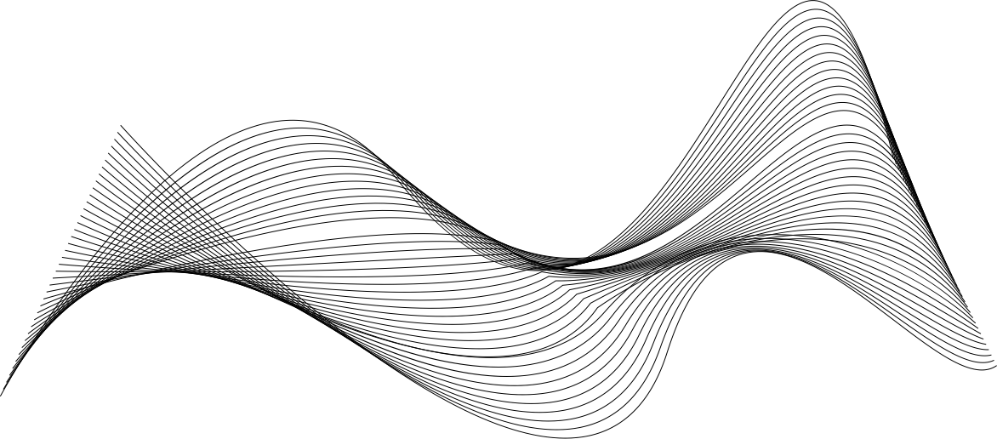
Module - 2
Development and Data Visualization using Streamlit

Slide 2

DISCLAIMER
The content is curated from online/offline resources and used for educational purpose only

Slide 3

Learning Objective
You will learn in this Chapter:
Apply modern web development skills using AI-assisted tools like GitHub Copilot and Cursor AI.
Enable rapid prototyping and data visualization through Streamlit for building interactive web applications.
Introduce AI integration techniques using tools like Gemini API for smart feature development (e.g., chatbots, content generation).
Develop proficiency in version control and cloud deployment using Git, GitHub, and Streamlit Community Cloud.
Empower learner to transfer industry-relevant skills to students, enhancing employability and innovation in academic projects.
Source :
Place your source text here

Slide 4

Learning Outcome
You will learn in this Chapter:
About the structure and workflow of a multi-page Streamlit application.
How to Design and build intuitive application pages.
How to use forms and input widgets to capture and process user input within an interactive app.
How to display dynamic data using basic charts and understand where and when to use each chart type effectively.

Slide 5

Introduction to Streamlit
Introduction
Streamlit is an open-source Python library for creating interactive web applications.
It is designed for data professionals to build apps without needing web development skills.
Applications are written entirely in Python, removing the need to use HTML, CSS, or JavaScript.
It supports various visualization libraries like Matplotlib, Plotly, and Altair.
Users can build dashboards, data analysis tools, and interactive visual reports quickly.
Streamlit allows integration of charts, sliders, buttons, and inputs with minimal code.
Source :
https://upload.wikimedia.org/wikipedia/commons/thumb/7/77/Streamlit-logo-primary-colormark-darktext.png/1280px-Streamlit-logo-primary-colormark-darktext.png
Notes:
Streamlit is a user-friendly Python library that simplifies the creation of web applications for data-related work. It is especially helpful for people who already know how to use Python but do not have experience in developing websites. Unlike traditional web development, which requires writing code in multiple languages such as HTML, CSS, and JavaScript, Streamlit allows users to build complete applications using only Python. This lowers the entry barrier for many data professionals and educators who want to share their work in an interactive format.
The structure of a Streamlit app is simple. When a user interacts with the app, for example by selecting a filter or adjusting a slider, the entire Python script runs again from top to bottom. This ensures that the interface is always updated based on the latest user input. While this may sound repetitive, it actually makes debugging and logic implementation easier, because developers do not need to manage separate front-end and back-end codebases.
One of Streamlit’s key strengths is its support for popular Python visualization libraries such as Matplotlib, Plotly, and Altair. This means users can generate different types of charts—line charts, bar charts, scatter plots, or even geographic maps—and display them directly in their web application. The visuals are not just static; users can interact with them, which makes the experience more engaging.

Slide 6
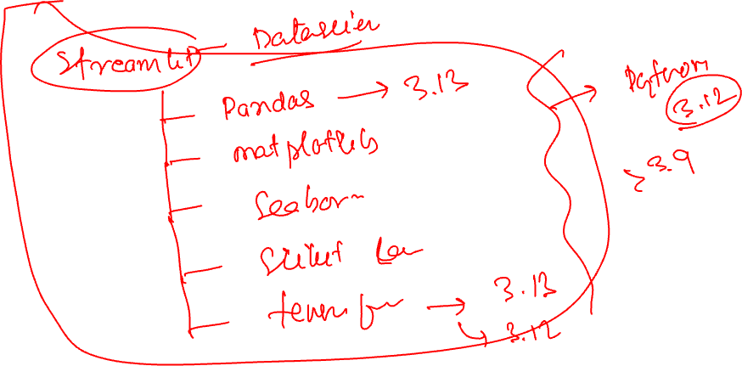

Slide 8
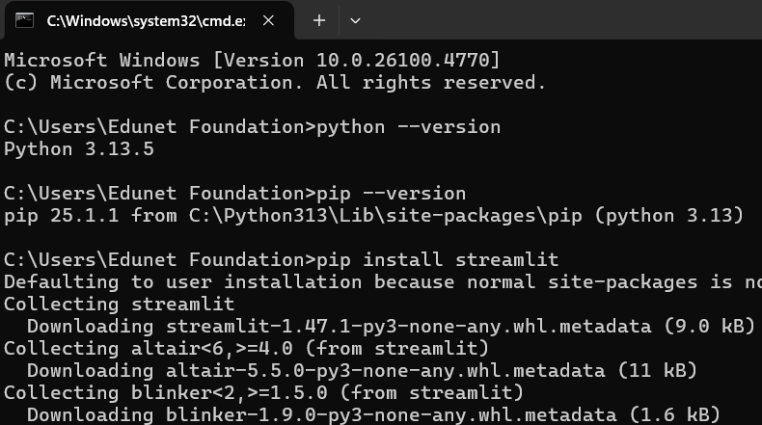
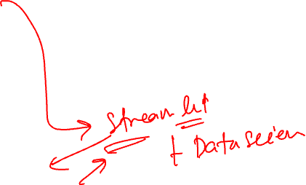
Introduction to Streamlit
Installing and Launching First Application
Streamlit is installed using the pip package manager in Python.
Ensure Python and pip are available before installing Streamlit.
Use python --version to check if Python is installed.
Use pip --version to confirm pip is available.
Run pip install streamlit to install the library.
After installation, applications can be created using Python scripts.
Use python – m streamlit run your_script.py to launch the app in a browser.
Source :
Screenshot
Notes:
Once we understand what Streamlit does, the next step is to install it and try creating a basic application.
Streamlit is a Python library, so it can be installed through the command-line interface using pip, which is the standard Python package manager.
Before beginning, it is important to ensure that both Python and pip are installed and working correctly on the system. This check can be done using simple commands in the command prompt.
To begin, open the command prompt and type python --version. This command will display the currently installed version of Python. If Python is installed correctly, the version number will appear.
Next, type pip --version to make sure the pip tool is available. Pip helps in downloading and installing packages such as Streamlit from the Python Package Index.
Once these two are confirmed, the installation of Streamlit is done by entering the command pip install streamlit. This will download the required files and install Streamlit along with its dependencies. The process usually takes a few moments depending on the internet speed and system performance.
After installation, any Python script that uses Streamlit can be run as a web application.
For example, if you create a file named first_app.py and write some Streamlit code inside it, you can launch it by typing python –m streamlit run first_app.py in the command prompt.
This command opens the application in your default web browser. The application will be interactive, and any user inputs such as sliders or buttons will be visible in the browser window.

Slide 9
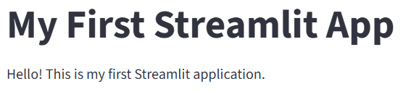
Introduction to Streamlit
Installing and Launching First Application
Create a new Python file, for example, app.py.
Open the file in a code editor and write basic Streamlit code. Sample code:
import streamlit as st
st.title("My First Streamlit App")
st.write("Hello! This is my first Streamlit application.")
Save the file after writing the code.
Open command prompt and navigate to the file’s directory using cd command.
Run the app using: python -m streamlit run app.py
The application will open in the default web browser.
Source :
Screenshot
Notes:
After installing Streamlit successfully, it is helpful to test it by creating and running a basic application. This process gives hands-on experience and builds confidence in using the tool.
The first step is to create a new Python file, such as app.py. This file will contain the Streamlit code that forms the structure of the application.
Open this file in any text editor or integrated development environment where you usually write Python code. Inside the file, write a few simple lines to test Streamlit’s basic functionality.
Now, create a simple web application that displays a title and a line of text in the browser window. After writing the code, save the file.
Next, open the command prompt and navigate to the folder where the file is saved using the cd command.
To launch the application, type the command python -m streamlit run app.py and press Enter. This command tells Python to use Streamlit to run the script named app.py.
Once the command is executed, Streamlit automatically starts a local development server and opens a new tab in the default web browser.
This tab will display the application output as designed in the script.

Slide 10
Introduction to Streamlit
Streamlit vs. Traditional Web Frameworks
Aspect | Traditional Web Frameworks | Streamlit
Technologies Required | Requires knowledge of multiple technologies and a server-side language like Python. | Requires only Python. Streamlit takes care of creating the interface automatically.
Flexibility and Features | Offers complete control over all aspects of the application, making it suitable for very complex and feature-rich applications. | More focused on creating data-driven applications, dashboards, and machine learning interfaces. Limited flexibility for very complex features.
Deployment | Requires careful configuration and deployment steps. | Applications can be deployed quickly with simpler commands or cloud services.
Best use Case | Building large-scale, multi-functional applications. | Building analytical dashboards, quick prototypes, and interactive machine learning tools.
Notes:
Traditional web frameworks are designed for building large, multi-functional applications. To use them, developers must learn multiple technologies. For example, HTML is used for the page structure, CSS for styling, JavaScript for interactivity, and a back-end language like Python or PHP for server-side processing. This results in a steep learning curve, especially for those coming from a non-web development background.
In contrast, Streamlit simplifies this process by allowing users to build interactive applications using only Python. It automatically manages the interface components and updates them when the script runs. This is helpful for Python users who may not have knowledge of front-end technologies. For example, a faculty member working on student performance data can build an interactive dashboard using Streamlit without writing any HTML or JavaScript.
Development time is another major difference. In traditional frameworks, developers must write and connect separate components for layout, design, and logic, which takes longer. Streamlit applications are quicker to build because everything is handled within a single Python script. Any interaction by the user, such as a button click or slider adjustment, causes the script to rerun and update the interface instantly.
When it comes to flexibility, traditional web frameworks offer complete control and are suitable for building portals, e-commerce platforms, or multi-user systems. Streamlit, however, is focused on creating data-driven applications. It is best suited for dashboards, quick prototypes, or machine learning model interfaces. While it does not provide all the features of a full-stack framework, it is sufficient for single-user or analytical tasks.
Deployment in traditional frameworks often requires configuring web servers, managing multiple files, and following detailed steps. In comparison, deploying a Streamlit app is straightforward. It can be done with simple commands or through cloud platforms that support Streamlit hosting.

Slide 11
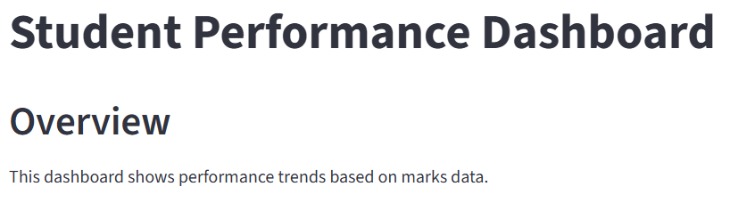
Introduction to Streamlit
Application Page
The application page is the web interface shown when a Streamlit app runs.
It displays elements such as titles, text, charts, tables, and widgets.
The layout follows the top-to-bottom sequence of commands in the Python script.
Changes made in the script appear on the page after refreshing.
The page is dynamic and updates quickly without restarting the app.
It is the main area where users interact with the Streamlit application.
Source :
Screenshot
Notes:
The application page in Streamlit is the visual output that opens in a web browser whenever a Streamlit script is executed. It acts as the front-end or user interface of the application.
Streamlit then starts a local server and, within a few seconds, opens the default browser with the live application. There is no need to open the browser manually or configure any server settings.
The layout of the application page is simple and follows a top-to-bottom order. This means that the commands written at the top of the script appear first on the page, and the commands written later appear below.
Another important feature is that the page is dynamic. When a developer makes a change in the Python script, such as modifying the text or updating the chart, there is no need to restart the application. Simply saving the script and refreshing the browser page will show the new content. This helps save time and makes the development process more efficient.
The application page is where all user interactions take place. Users can move sliders, click buttons, select options, and view real-time outputs. This makes the application interactive and useful for tasks such as exploring data, analyzing patterns, or visualizing predictions.

Slide 12
Introduction to Streamlit
Steps for Creating a Simple Application Page
Open a code editor and create a new Python file. Import the Streamlit library using import streamlit as st
Add page elements using Streamlit functions like st.title(), st.header(), and st.write().
Example:
st.title("Student Performance Dashboard")
st.header("Overview")
st.write("This dashboard shows performance trends based on marks data.")
Save the file after adding code.
Open command prompt and navigate to the folder where the file is saved.
Run the application using: python -m streamlit run dashboard.py
The browser will open and display the application page with the given content.
Notes:
The first step is to open any Python-compatible code editor and create a new file. The file can be named dashboard.py or any name of choice with a .py extension.
At the top of this file, the Streamlit library needs to be imported. This is done by writing import streamlit as st.
This line allows us to use all of Streamlit’s functions by calling them with the prefix st.. After importing, we can start adding visual elements to the application.
For instance, using st.title() adds a large title on the page, st.header() adds a sub-heading, and st.write() displays simple text.
A sample code could include:
st.title("Student Performance Dashboard")
st.header("Overview")
st.write("This dashboard shows performance trends based on marks data.")
This code, when executed, will create a structured application page with a title at the top, followed by a header and an explanatory line. After writing this code, the file should be saved.
To run the application, the command prompt should be opened and navigated to the folder where the script is saved using the cd command.
Once in the correct folder, the command python -m streamlit run dashboard.py can be used to launch the app.
This command tells Python to run the file using Streamlit. Upon execution, the default browser opens automatically, showing the application page with the elements that were defined in the script.

Slide 13
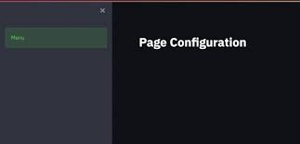
Introduction to Streamlit
Page Configuration
Streamlit provides a function called st.set_page_config() to control the layout and appearance of the web page.
This function must be placed at the very beginning of the script.
The page_title sets the browser tab title of the Streamlit application.
The page_icon defines the small icon on the browser tab, which can be an image or symbol.
The layout parameter can be "centered" or "wide" to adjust horizontal spacing.
The initial_sidebar_state controls whether the sidebar starts expanded or collapsed.
Source :
https://encrypted-tbn0.gstatic.com/images?q=tbn:ANd9GcRzMB-hoL4S-2omyhafBi2npkvKbwQFRSwrlw&s
Notes:
When a Streamlit application is created, the default browser page comes with a standard look, including a basic title and the Streamlit icon. In many cases, it is important to make the web application look more professional and aligned with its specific purpose.
Streamlit provides a built-in function called st.set_page_config() which allows such customization. This function should always be written at the very beginning of the Python script. If this function is placed later in the script, Streamlit will show a warning, and the settings may not work properly.
There are four main parameters that can be configured using this function.
The first one is page_title, which lets you define what title appears on the browser tab. This is useful when multiple tabs are open, as users can easily identify the application.
The second parameter is page_icon. This sets the small image on the browser tab, also known as the favicon. This can be either an image file stored in the same folder as your Python script or a symbol.
The third parameter is layout. It decides how the content appears on the page. The default value is "centered", which keeps all elements in the middle of the screen. But if the application displays a lot of charts or tables, choosing "wide" will utilize the full width of the screen, making the layout more spacious.
The final parameter is initial_sidebar_state, which controls whether the sidebar is open or closed when the application first loads. If your application relies heavily on user inputs through the sidebar, such as selecting categories or filters, then keeping it expanded makes sense. On the other hand, if the sidebar is not very important, you can keep it collapsed to give more space to the main content.

Slide 14
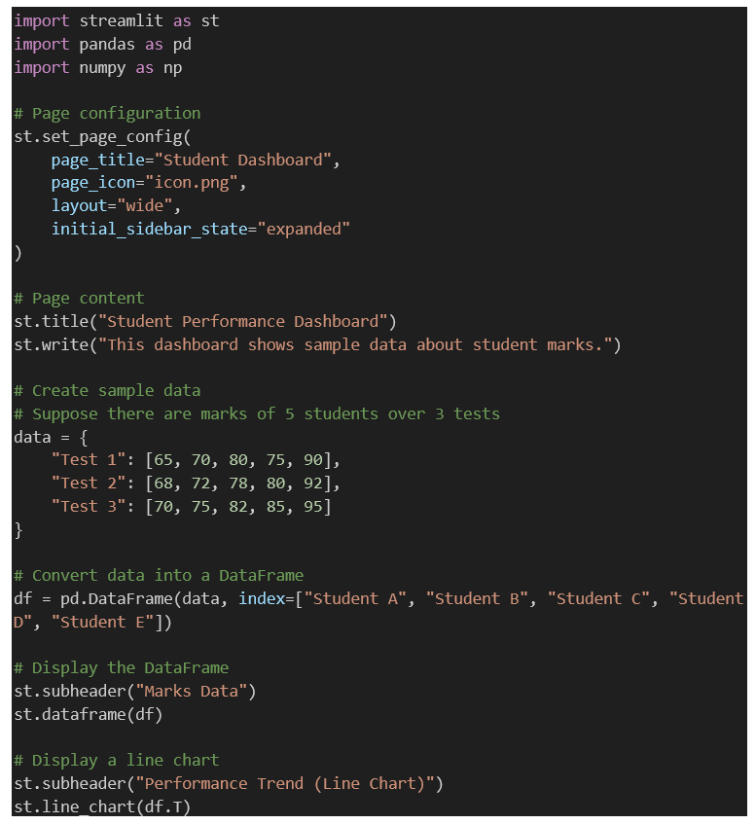
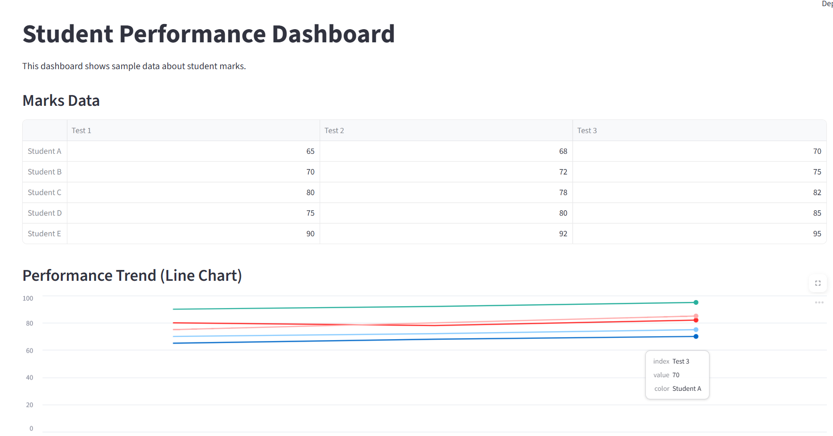
Introduction to Streamlit
Example of Page Configuration
Code
Output
Source :
Screenshot
Notes:
Please note that the code is given below and can be directly taken from here.
import streamlit as st
import pandas as pd
import numpy as np
# Page configuration
st.set_page_config(
page_title="Student Dashboard",
page_icon="icon.png",
layout="wide",
initial_sidebar_state="expanded"
)
# Page content
st.title("Student Performance Dashboard")
st.write("This dashboard shows sample data about student marks.")
# Create sample data
# Suppose there are marks of 5 students over 3 tests
data = {
"Test 1": [65, 70, 80, 75, 90],
"Test 2": [68, 72, 78, 80, 92],
"Test 3": [70, 75, 82, 85, 95]
}
# Convert data into a DataFrame
df = pd.DataFrame(data, index=["Student A", "Student B", "Student C", "Student D", "Student E"])
# Display the DataFrame
st.subheader("Marks Data")
st.dataframe(df)
# Display a line chart
st.subheader("Performance Trend (Line Chart)")
st.line_chart(df.T)

Slide 15
Introduction to Streamlit
Project Directory Structure
Example of structured multi-file project:
student_dashboard/
app.py
pages/
page_1.py
page_2.py.
data/
Data files like marks.csv
Images
Visual assets like logo.png
modules/
Reusable code like helper_functions.py.
As the size of a Streamlit project increases, organizing files becomes important.
A simple application can be written in a single file like app.py.
Larger applications benefit from a well-structured folder system.
Example of simple project structure:
project_folder/
app.py
Notes:
As Streamlit applications become more complex, having a well-organized project directory becomes essential. When all the code and resources are placed into a single file, it becomes difficult to manage, especially when there are updates or new features to be added. A good structure helps both in developing and maintaining the application over time.
For very small or demo-level applications, placing all code in a single file such as app.py is acceptable. It helps to keep things minimal and quick for testing. However, once the application starts using multiple pages, reading data from files, or displaying images and charts, separating these resources into appropriate folders becomes a best practice.
In a structured example, the app.py file is still the main entry point of the application.
It usually contains the code for the main dashboard or homepage. The pages folder is used when creating a multi-page app. Streamlit can automatically identify Python files placed inside this folder and show them as tabs or pages in the sidebar. This means that each page’s code is isolated and easy to manage.
The data folder is used to store datasets such as CSV files. These files can be student records, sales data, survey results, or anything else the application needs to analyze or display. By storing them in a separate folder, they are easier to locate, update, or replace without modifying the code.
Similarly, the images folder holds visual files such as logos, banners, or background images that are used to improve the look of the dashboard. These might be profile pictures, icons, or visual explanations in the interface.
The modules folder stores custom Python files with reusable functions. For instance, if the same data cleaning logic is used on multiple pages, that function can be stored in helper_functions.py and reused wherever required. This reduces repetition in the code and also makes debugging easier when changes are needed.

Slide 16

Lab Activity
Lab 1 - App Page Configuration and Creation

Slide 17

Core UI Component
Display Elements – Text and Formatting
Text elements help in displaying headings, instructions, and descriptions in Streamlit applications.
st.title() displays the main title of the application.
st.header() is used to define section headings.
st.subheader() creates sub-sections under headers.
st.write() displays text, data, or even charts.
st.text() shows plain text exactly as written, without formatting.
st.markdown() allows the use of formatted text.
Source :
Icon
Notes:
In a Streamlit application, text display plays a major role in improving the user interface and guiding users through the dashboard or data report. These elements are not just about aesthetics; they are functional components that help in communication, navigation, and information clarity.
Let us understand each function in more detail with practical context.
The st.title() function is used to define the main title of the entire Streamlit app. It is displayed in bold and large font, typically at the top of the page.
Next, we have st.header() which is slightly smaller than the title. It is used to divide the application into clear sections.
Further, to break content into even smaller parts, we use st.subheader(). This helps in making the content easier to read.
The st.write() function is a versatile function that intelligently decides how to display the input. It can accept text, numbers, lists, tables, charts, and even plots from libraries like Matplotlib or Altair.
The st.text() function is used when we want to show text exactly as it is, without any formatting. This is useful for showing source information, fixed descriptions, or disclaimers.
Lastly, st.markdown() is used when we want to use formatting like bold, italics, or bullet points. Markdown is a simple syntax used for formatting text. In Streamlit, this is especially useful when we want to highlight key insights.

Slide 18

Core UI Component
Display Elements – Data Display Elements
A key purpose of Streamlit applications is to present data clearly so that users can understand and analyze it.
Streamlit provides built-in functions to display structured data such as tables, metrics, and JSON in a readable format.
st.dataframe() - User can explore a dataset.
st.table() - For smaller or summary datasets.
st.metric() - To highlight key figures.
st.json() - To display structured data from external APIs or configurations.
Source :
Icon
Notes:
The goal of any data application is to present information in a way that is both clear and easy to understand. These components help developers do just that, depending on the kind of data and how users are expected to interact with it.
The st.dataframe() function allows users to interact with the dataset.
The st.table() function provides a simpler, static view.
The st.metric() function is valuable in dashboards.
The st.json() function is useful in slightly more technical settings. It clearly helps in debugging or sharing structured data with others.

Slide 19

Core UI Component
Display Elements – Text and Input Widgets
Streamlit supports dynamic applications using interactive input widgets.
Input widgets allow users to enter text, numbers, dates, and time.
Common input widgets include:
st.text_input() – For single-line text input.
st.text_area() – For multi-line text input.
st.number_input() – For numeric input.
st.date_input() – For selecting dates.
st.time_input() – For selecting time.
Source :
Icon
Notes:
These widgets are important because they allow users to actively participate in the application by entering or selecting data, instead of just passively viewing content.
Let us start with st.text_input(). This widget is used when we want the user to type a single line of text.
Next is st.text_area(), which is useful when we expect longer input like feedback, suggestions, or student reflections.
The st.number_input() widget is for entering numeric values. It is flexible as it supports minimum and maximum limits, and step size.
Moving forward, the st.date_input() widget provides a calendar pop-up to select a date.
Similarly, st.time_input() allows users to select a time, which can be useful for setting exam start times or appointment slots.

Slide 20

Core UI Component
Display Elements – Button and Action Widgets
Action widgets help trigger specific tasks.
These widgets control when actions occur.
Common action widgets include:
st.button() – Executes logic only when clicked.
st.checkbox() – Toggles visibility of elements based on True/False.
st.radio() – Allows selection of one option among many.
st.selectbox() – Dropdown to choose a single item.
st.multiselect() – Allows selection of multiple values.
st.slider() and st.select_slider() – Select numeric or categorical values using a slider.
Source :
Icon
Notes:
In Streamlit, action widgets are interactive controls that allow users to trigger or manage the behavior of the application. These widgets are particularly useful when we want the app to perform a specific task only when the user chooses to, instead of every time the page reloads. Let us go through each of the commonly used action widgets and how they function in a practical application.
The st.button() is a simple clickable button. When a user clicks this button, the logic written inside the conditional block is executed.
The st.checkbox() is a toggle switch that returns either True or False. It is useful when we want to show or hide a particular section based on user preference.
Next, the st.radio() widget is used when the user needs to choose only one option among multiple.
The st.selectbox() functions similarly to a dropdown menu. It allows the user to pick one item from a list.
If we want the user to choose more than one item, then st.multiselect() is used. This is ideal in cases like selecting hobbies, where multiple interests can be selected from a list such as Reading, Music, Sports, or Art. The selected items can then be displayed or used for some analysis.
The st.slider() and st.select_slider() are widgets for selecting numeric or categorical values by sliding. For instance, a student can select their marks using a slider ranging from 0 to 100. This allows for precise selection and is useful in scenarios where data is numerical or ordinal.

Slide 21

Core UI Component
Introduction to Navigation and Multi-Page Layouts
Single-page apps are suitable for small tools but not for complex applications.
Multi-page layout improves readability, structure, and user experience.
Streamlit uses a folder named pages/ to manage multiple pages.
Each Python file inside pages/ becomes an independent page.
The main script (e.g., app.py) serves as the default landing page.
A navigation menu appears automatically in the sidebar.
Source :
Icon
Notes:
As applications grow larger and more complex, managing all the content on a single page becomes difficult for both the developer and the user.
Streamlit makes this process easy. All we need to do is create a folder named pages/. Any Python file added to this folder is treated as a separate page. These pages load individually when clicked, just like switching between tabs in a browser. This separation ensures that the code for each section is modular and easier to maintain.
The main file—typically named app.py or main.py—acts as the default starting point of the app. It is the first page users see when they open the application. This page can be used as a dashboard, summary page, or welcome screen, depending on the app’s purpose.
Streamlit automatically adds a navigation menu on the left sidebar using the names of these Python files. These names can also be changed for better readability.
Each page runs independently. So, if the user switches from one page to another, only the selected page’s code is executed. However, if you want to share data like user inputs, selections, or computed results across different pages, you can use the Streamlit session state. This helps in creating a smooth flow of data without reloading or re-entering information.

Slide 22
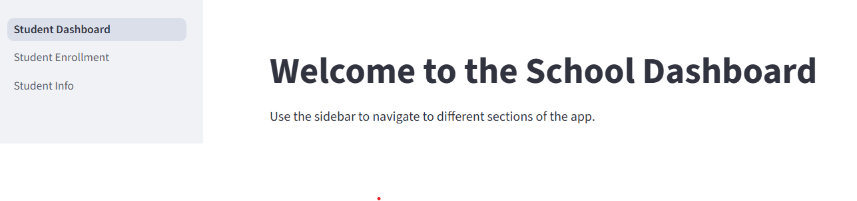
Core UI Component
Steps to create Multi-Page Layouts
Create a Main File (e.g., app.py): Use st.set_page_config() to set title and layout.
Add a welcome message and guide users to use sidebar.
Create a pages/ Folder: Store separate Python files for each section (e.g., Student_Info.py, Subject_Enrollment.py).
Add Page-Specific Code:
In Student_Info.py: Show student profile section.
In Subject_Enrollment.py: Allow subject selection.
Run the App: Use the command: python -m streamlit run app.py.
Source :
Screenshot
Notes:
Please note that the code is given in the handbook.
The learners can directly take the code from the there to create the application.
To create a multi-page app, you should start by writing a main file, such as app.py, that includes a simple welcome screen.
Using st.set_page_config(), you can configure the app title and layout. Then, create a folder named pages in the same directory and add additional files for each page.
For example, a file named Student_Info.py can include a section that allows users to view and manage student profiles using basic commands like st.title() and st.write().
Another file, Subject_Enrollment.py, can allow users to select subjects using a st.multiselect() component.
For example, the user can pick subjects such as Mathematics, Physics, or Economics from a checklist and see the selected options displayed. These features help simulate a real-world educational dashboard where students or faculty members can interact with data.
To run the app, use the command python -m streamlit run app.py. Once executed, the sidebar will automatically list all the pages inside the pages folder. Users can click on any listed section to load that page, which makes it very easy to switch between functionalities. This method also keeps the code organized and easier to maintain.

Slide 23
Lab Activity
Lab 2 - Building Interactive UIs in Streamlit

Slide 24
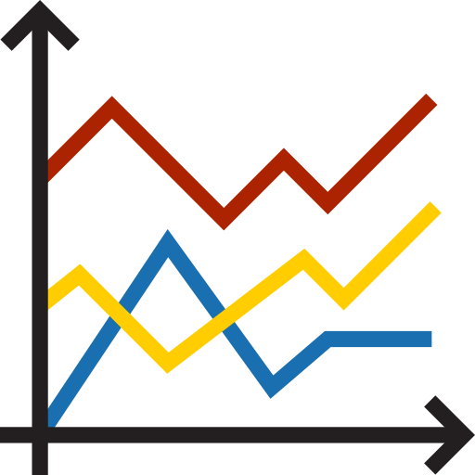
Visualization
Line Chart
A line chart is a simple chart type used to represent information that changes continuously over time.
It shows data points connected by straight lines to illustrate trends or progress.
The x-axis typically shows time intervals and y-axis shows values.
Line charts help users identify patterns, trends, and fluctuations in data.
They are widely used in education, business, and engineering fields.
Dashboards with line charts support quicker decisions by showing trends visually.
Source :
Icon
Notes:
A line chart is one of the most commonly used charts when data is collected over a period of time. It is especially useful for representing continuous change. For example, in an academic setting, a teacher may want to display how a student’s marks have changed across multiple tests during a semester. Each data point can represent one test, and connecting them with lines makes the pattern of improvement or decline easier to spot.
In the line chart, the horizontal axis usually represents time – such as days, weeks, months, or academic terms – and the vertical axis shows the corresponding values. These values could be marks scored, percentage of attendance, electricity consumption in a lab, or even the count of library logins per week.
This type of visualization is often used in dashboards because it is easy to read and interpret.

Slide 25
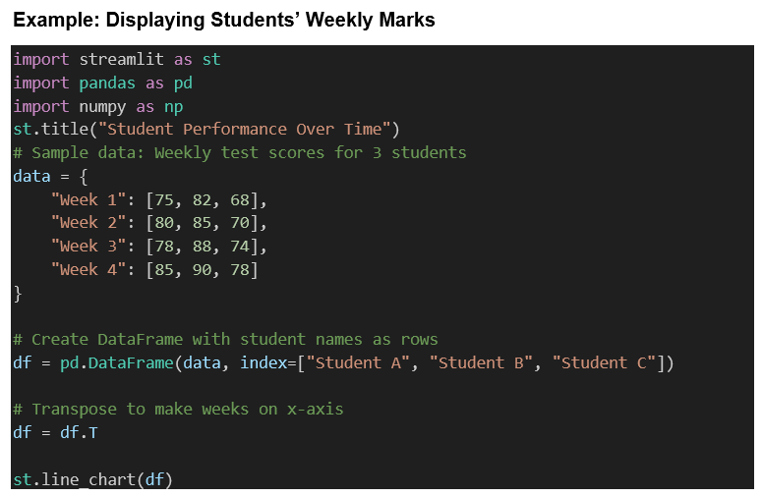
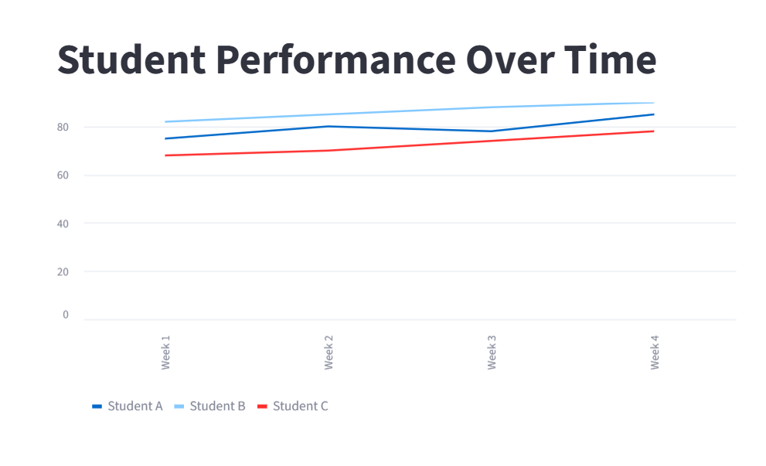
Visualization
Creating a Line Chart in Streamlit
Code
Output
Source :
Screenshot
Notes:
Please note that the code is given below and can be directly taken from here.
import streamlit as st
import pandas as pd
import numpy as np
st.title("Student Performance Over Time")
# Sample data: Weekly test scores for 3 students
data = {
"Week 1": [75, 82, 68],
"Week 2": [80, 85, 70],
"Week 3": [78, 88, 74],
"Week 4": [85, 90, 78]
}
# Create DataFrame with student names as rows
df = pd.DataFrame(data, index=["Student A", "Student B", "Student C"])
# Transpose to make weeks on x-axis
df = df.T
st.line_chart(df)

Slide 26

Visualization
Bar Chart
A bar chart is a type of chart that uses rectangular bars to show and compare values across categories.
The height or length of each bar represents the quantity of data in that category.
Vertical bar charts use height; horizontal bar charts use length.
Bar charts are used for comparison, not for showing trends over time.
Source :
Icon
Notes:
A bar chart is a fundamental and widely used method of data visualization. It uses bars to represent numerical values associated with categories. Each bar is proportional to the value it represents. Vertical bar charts display bars rising upward, while horizontal bar charts extend bars to the right. Bar charts are especially useful when the goal is to compare values across different groups or categories, rather than track changes over time.

Slide 27
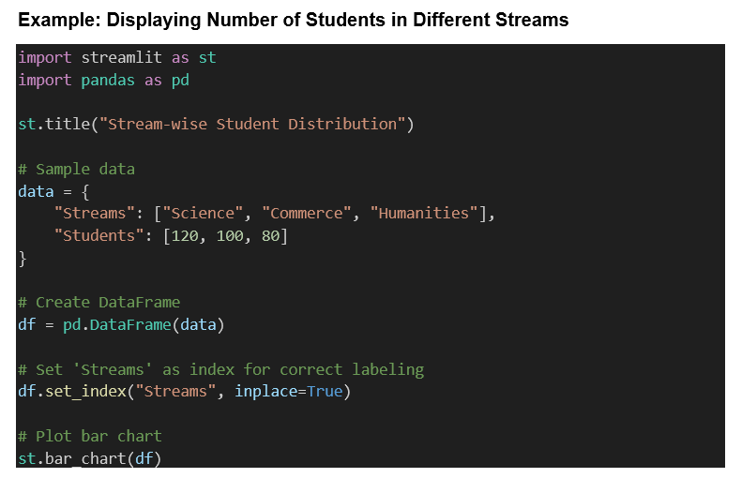
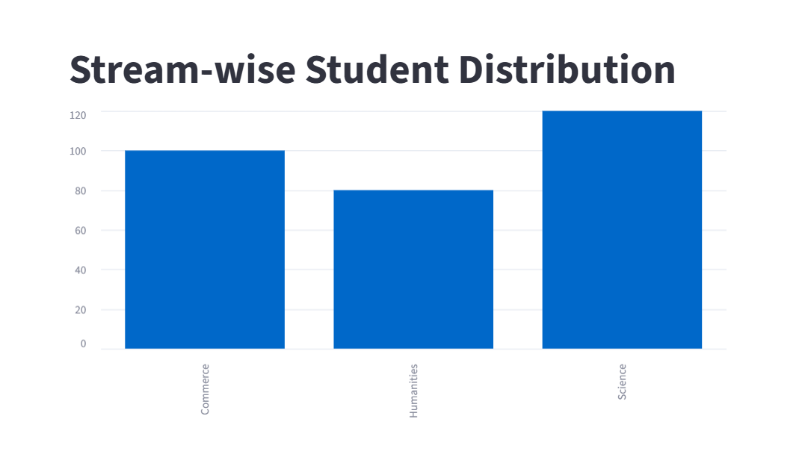
Visualization
Creating a Bar Chart in Streamlit
Code
Output
Source :
Screenshot
Notes:
Please note that the code is given below and can be directly taken from here.
import streamlit as st
import pandas as pd
st.title("Stream-wise Student Distribution")
# Sample data
data = {
"Streams": ["Science", "Commerce", "Humanities"],
"Students": [120, 100, 80]
}
# Create DataFrame
df = pd.DataFrame(data)
# Set 'Streams' as index for correct labeling
df.set_index("Streams", inplace=True)
# Plot bar chart
st.bar_chart(df)

Slide 28
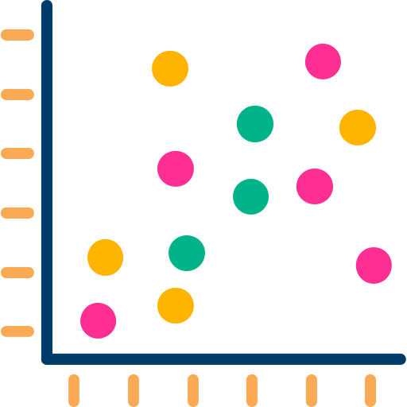
Visualization
Scatterplot Chart
A scatterplot chart is a two-dimensional graph that shows individual data points using dots.
Each dot represents one observation and is placed according to two variables: one on the x-axis and one on the y-axis.
Scatterplots are used to analyze relationships or patterns between the two variables.
It does not connect the dots with lines or bars, which makes it suitable for comparing non-sequential data.
Source :
Screenshot
Notes:
A scatterplot chart is a simple but powerful visualization tool that uses dots to display values for two different variables. Each dot on the chart represents one data point. The x-axis usually represents one variable, like the number of study hours, and the y-axis represents another variable, such as test scores. By plotting this way, it becomes easier to visually analyze whether there is any correlation between the two.

Slide 29
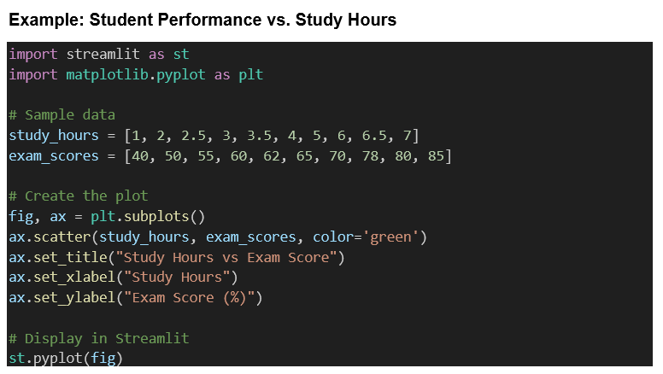
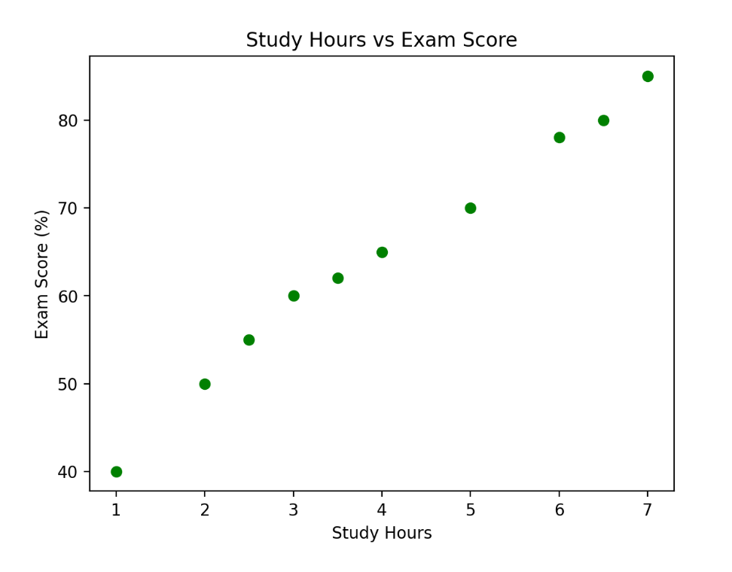
Visualization
Creating a Scatterplot Chart in Streamlit
Code
Output
Source :
Screenshot
Notes:
Please note that the code is given below and can be directly taken from here.
import streamlit as st
import matplotlib.pyplot as plt
# Sample data
study_hours = [1, 2, 2.5, 3, 3.5, 4, 5, 6, 6.5, 7]
exam_scores = [40, 50, 55, 60, 62, 65, 70, 78, 80, 85]
# Create the plot
fig, ax = plt.subplots()
ax.scatter(study_hours, exam_scores, color='green')
ax.set_title("Study Hours vs Exam Score")
ax.set_xlabel("Study Hours")
ax.set_ylabel("Exam Score (%)")
# Display in Streamlit
st.pyplot(fig)

Slide 30
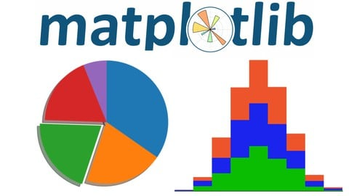
Visualization
st.pyplot
st.pyplot() is a function used to display Matplotlib charts in a Streamlit web app.
It allows for advanced customization of charts, including axis labels, titles, and annotations.
It is useful when Streamlit’s built-in charts like st.line_chart() or st.bar_chart() are not sufficient.
It is ideal for scenarios that require multiple data series or fine control over chart appearance.
To use it, first create a chart using Matplotlib and then pass the figure to st.pyplot().
Source :
https://img-c.udemycdn.com/course/480x270/4650772_3d84.jpg
Notes:
st.pyplot() is a powerful method provided by Streamlit to integrate visualizations created using Matplotlib directly into a web application. Unlike the basic chart functions like st.line_chart() or st.bar_chart(), which are limited to quick visualizations, st.pyplot() is used when a developer or data analyst needs to build more customized charts with greater control. For example, if you want to show a graph that compares exam performance across three sections, and you need to label each axis, add a legend, set grid lines, and maybe add an annotation for a particular outlier – these tasks are better handled using Matplotlib.

Slide 31
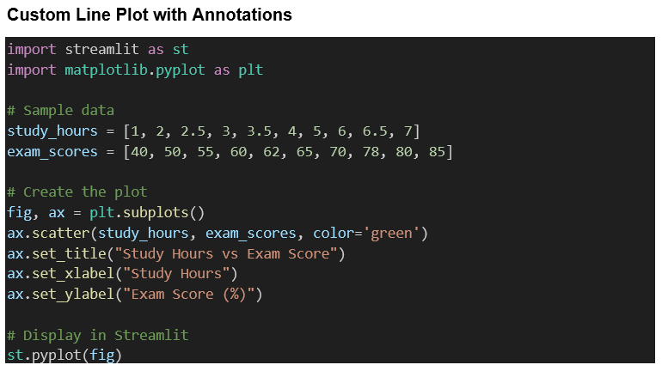
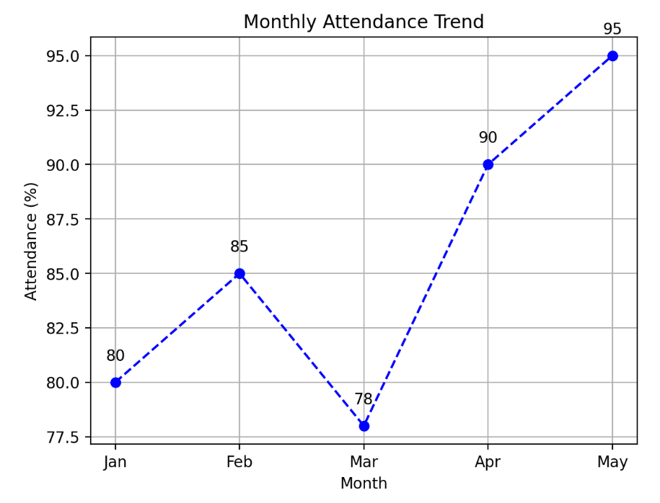
Visualization
Creating a Custom Line Plot with Annotations in Streamlit
Code
Output
Source :
Screenshot
Notes:
Please note that the code is given below and can be directly taken from here.
import streamlit as st
import matplotlib.pyplot as plt
# Sample data
study_hours = [1, 2, 2.5, 3, 3.5, 4, 5, 6, 6.5, 7]
exam_scores = [40, 50, 55, 60, 62, 65, 70, 78, 80, 85]
# Create the plot
fig, ax = plt.subplots()
ax.scatter(study_hours, exam_scores, color='green')
ax.set_title("Study Hours vs Exam Score")
ax.set_xlabel("Study Hours")
ax.set_ylabel("Exam Score (%)")
# Display in Streamlit
st.pyplot(fig)

Slide 32
Lab Activity
Lab 3 - Loading and Displaying Datasets in Streamlit Apps

Slide 33
Reference
Chart elements - Streamlit Docs. (n.d.). https://docs.streamlit.io/develop/api-reference/charts
Create a multipage app - Streamlit Docs. (n.d.). https://docs.streamlit.io/get-started/tutorials/create-a-multipage-app
Examples — Matplotlib 3.10.5 documentation. (n.d.). https://matplotlib.org/stable/gallery/index.html
GeeksforGeeks. (2025, July 16). A Beginners guide to Streamlit. GeeksforGeeks. https://www.geeksforgeeks.org/python/a-beginners-guide-to-streamlit/
st.bar_chart - Streamlit Docs. (n.d.). https://docs.streamlit.io/develop/api-reference/charts/st.bar_chart
St.Page - Streamlit Docs. (n.d.). https://docs.streamlit.io/develop/api-reference/navigation/st.page
St.pyplot - Streamlit docs. (n.d.). https://docs.streamlit.io/develop/api-reference/charts/st.pyplot
streamlit. (2025, July 25). PyPI. https://pypi.org/project/streamlit/
st.scatter_chart - Streamlit Docs. (n.d.). https://docs.streamlit.io/develop/api-reference/charts/st.scatter_chart
st.set_page_config - Streamlit Docs. (n.d.). https://docs.streamlit.io/develop/api-reference/configuration/st.set_page_config
Text elements - Streamlit Docs. (n.d.). https://docs.streamlit.io/develop/api-reference/text

Slide 34





Slide 35

Quiz
Which visualization type is recommended for showing trends over continuous time?
Pie chart
Table
Bar chart
Line chart
Answer: D
Line chart

Slide 36
Quiz
What immediate visual proof confirms Streamlit is running after executing the launch command?
Desktop notification
Browser tab opening with the app page
VSCode message
Terminal color change
Answer: B
Browser tab opening with the app page

Slide 37
Quiz
A Streamlit script file executes in what order each time it runs?
Bottom to top
Selected lines only
Top to bottom
Random order
Answer: C
Top to bottom

Slide 38
Quiz
Selecting a numerical value between 0 and 100 with drag interaction is done using ___.
st.text_area()
st.slider()
st.number_input()
st.selectbox()
Answer: B
st.slider()

Slide 39
Quiz
Which Streamlit function is used to display the main title at the top of an app page?
st.header()
st.markdown()
st.title()
st.subheader()
Answer: C
st.title()

Slide 40
Thank You

